Slide 1

Revolutionising the service industry
Submitted to-
Dr Rachna Yadav
FEC - 11
AYAN MAHAJAN :: 2K22/A13/61 ANSH MITTAL :: 2K22/A13/44

Slide 2


TABLE OF CONTENTS
Introduction
Business plan
Unique features
Real time interaction
Payment mode
Challenges
Future Goals

Slide 3
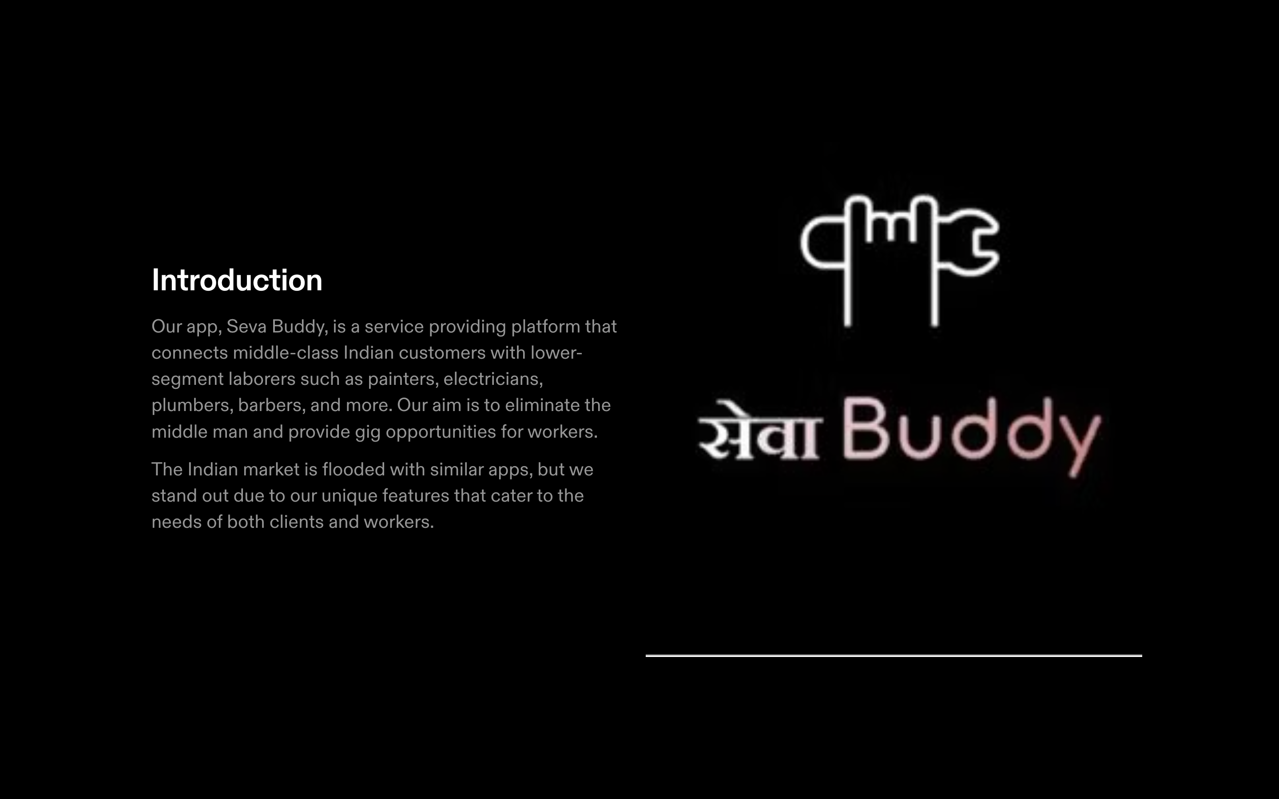

Slide 4
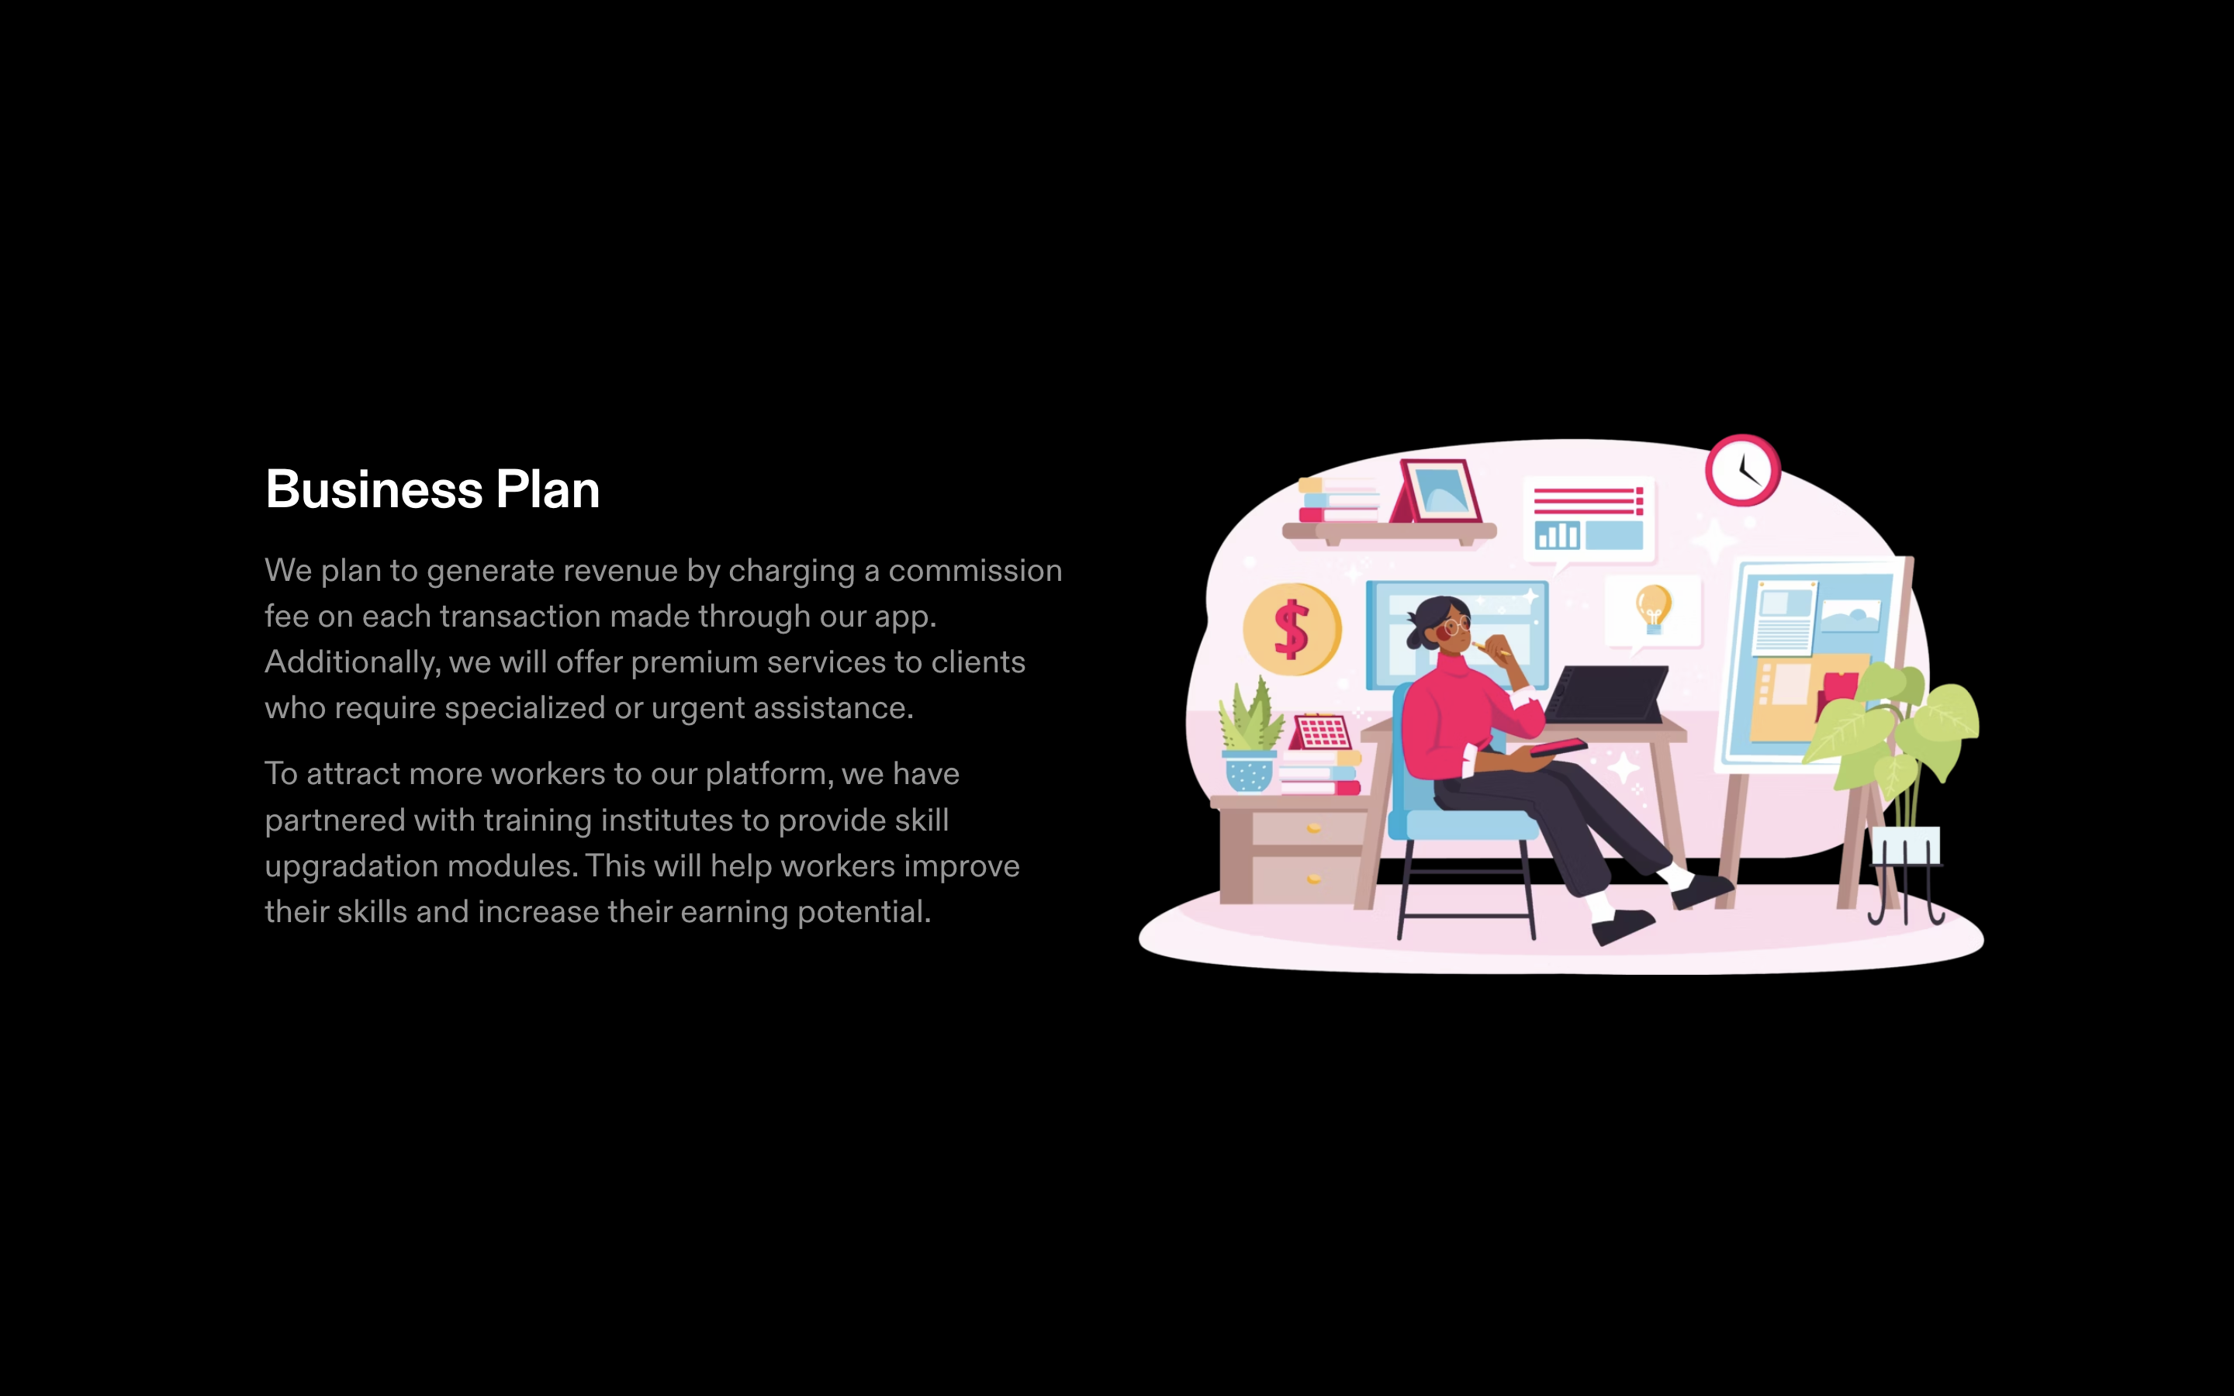

Slide 5
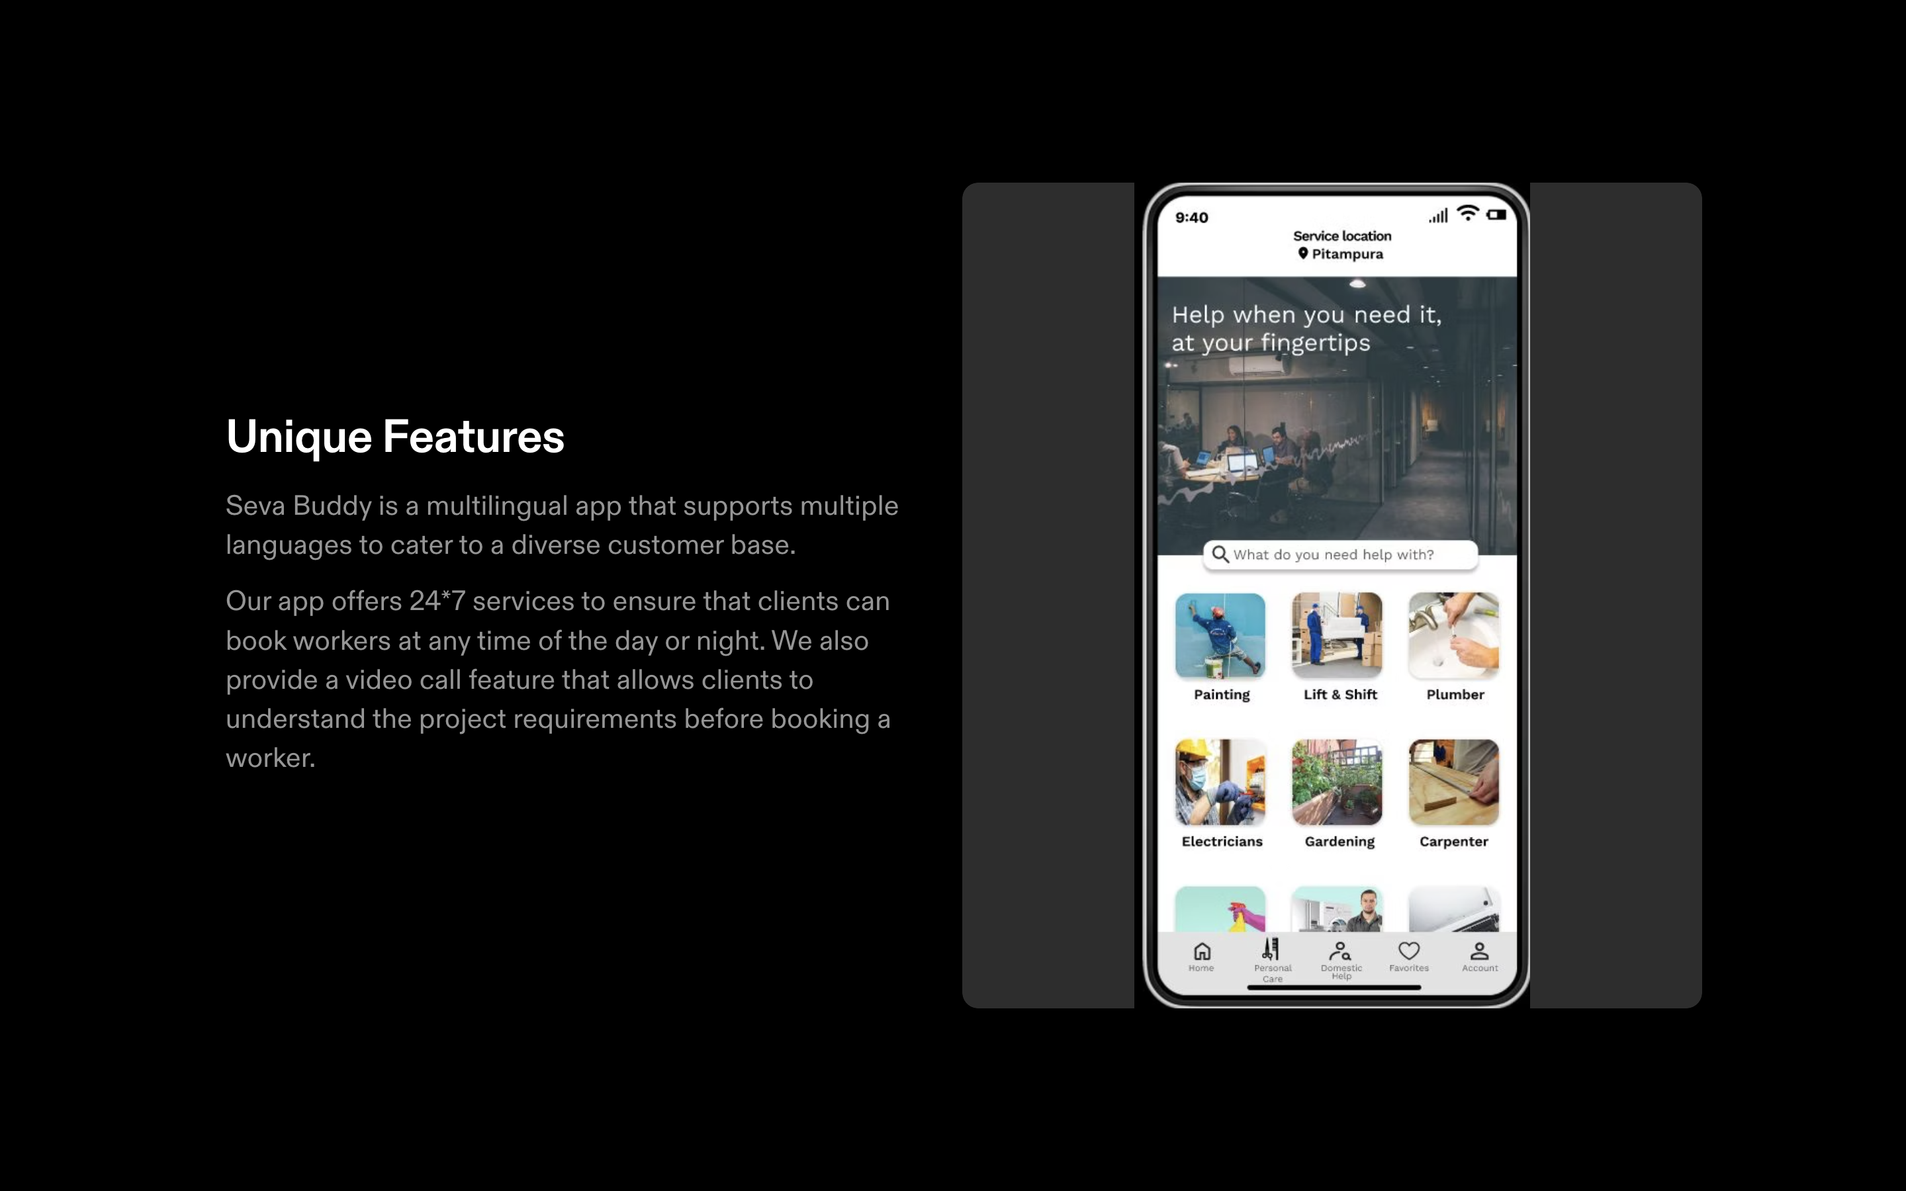

Slide 6
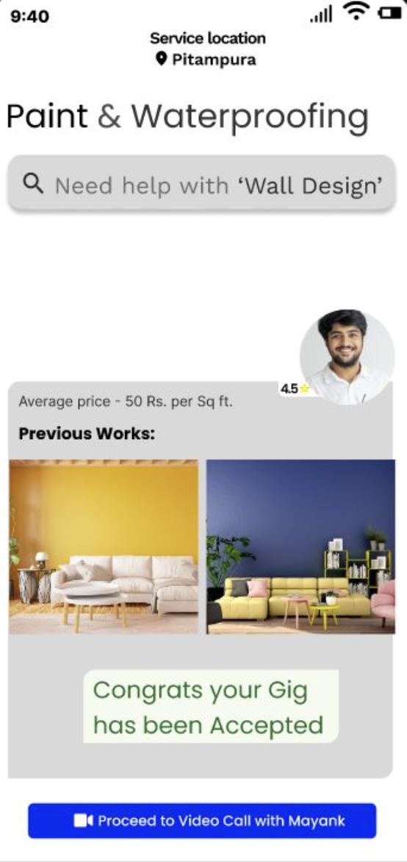

Video calling is supported on the app so that you can interact with your helper in real time explaining him the task.
The helper shall understand the problem and accept or decline to perform the problem as per his capabilities as well as provide you with an estimate price to save time

Slide 7
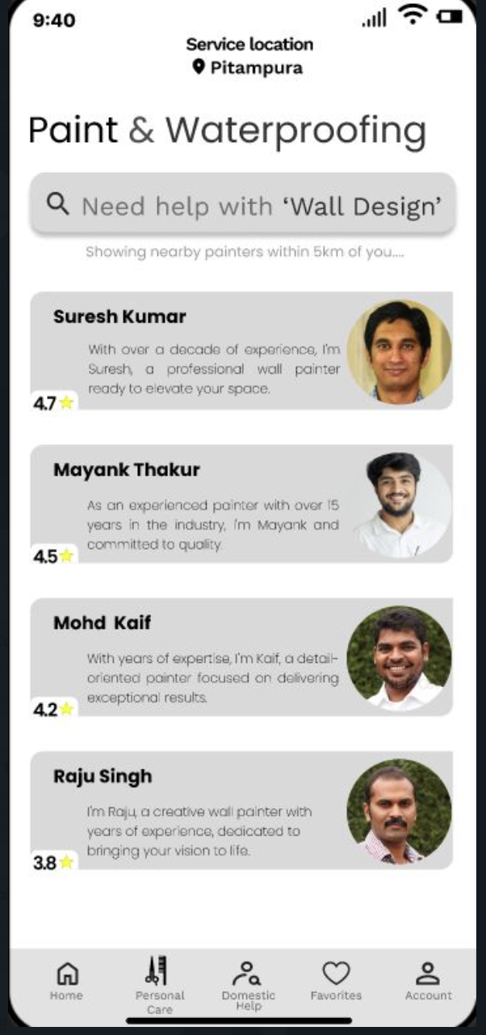
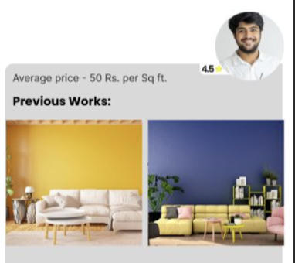
Star based sorting and images of previous works (uploaded by the helpers past customers) will help the new customers choose the helper whose taste matches with their choice so that the can get the work done according to their needs
So as to make sure that each helper gets an equal opportunity, we have introduces a star based charge system in which the price of each worker will increase or decrease with their ratings

Slide 8
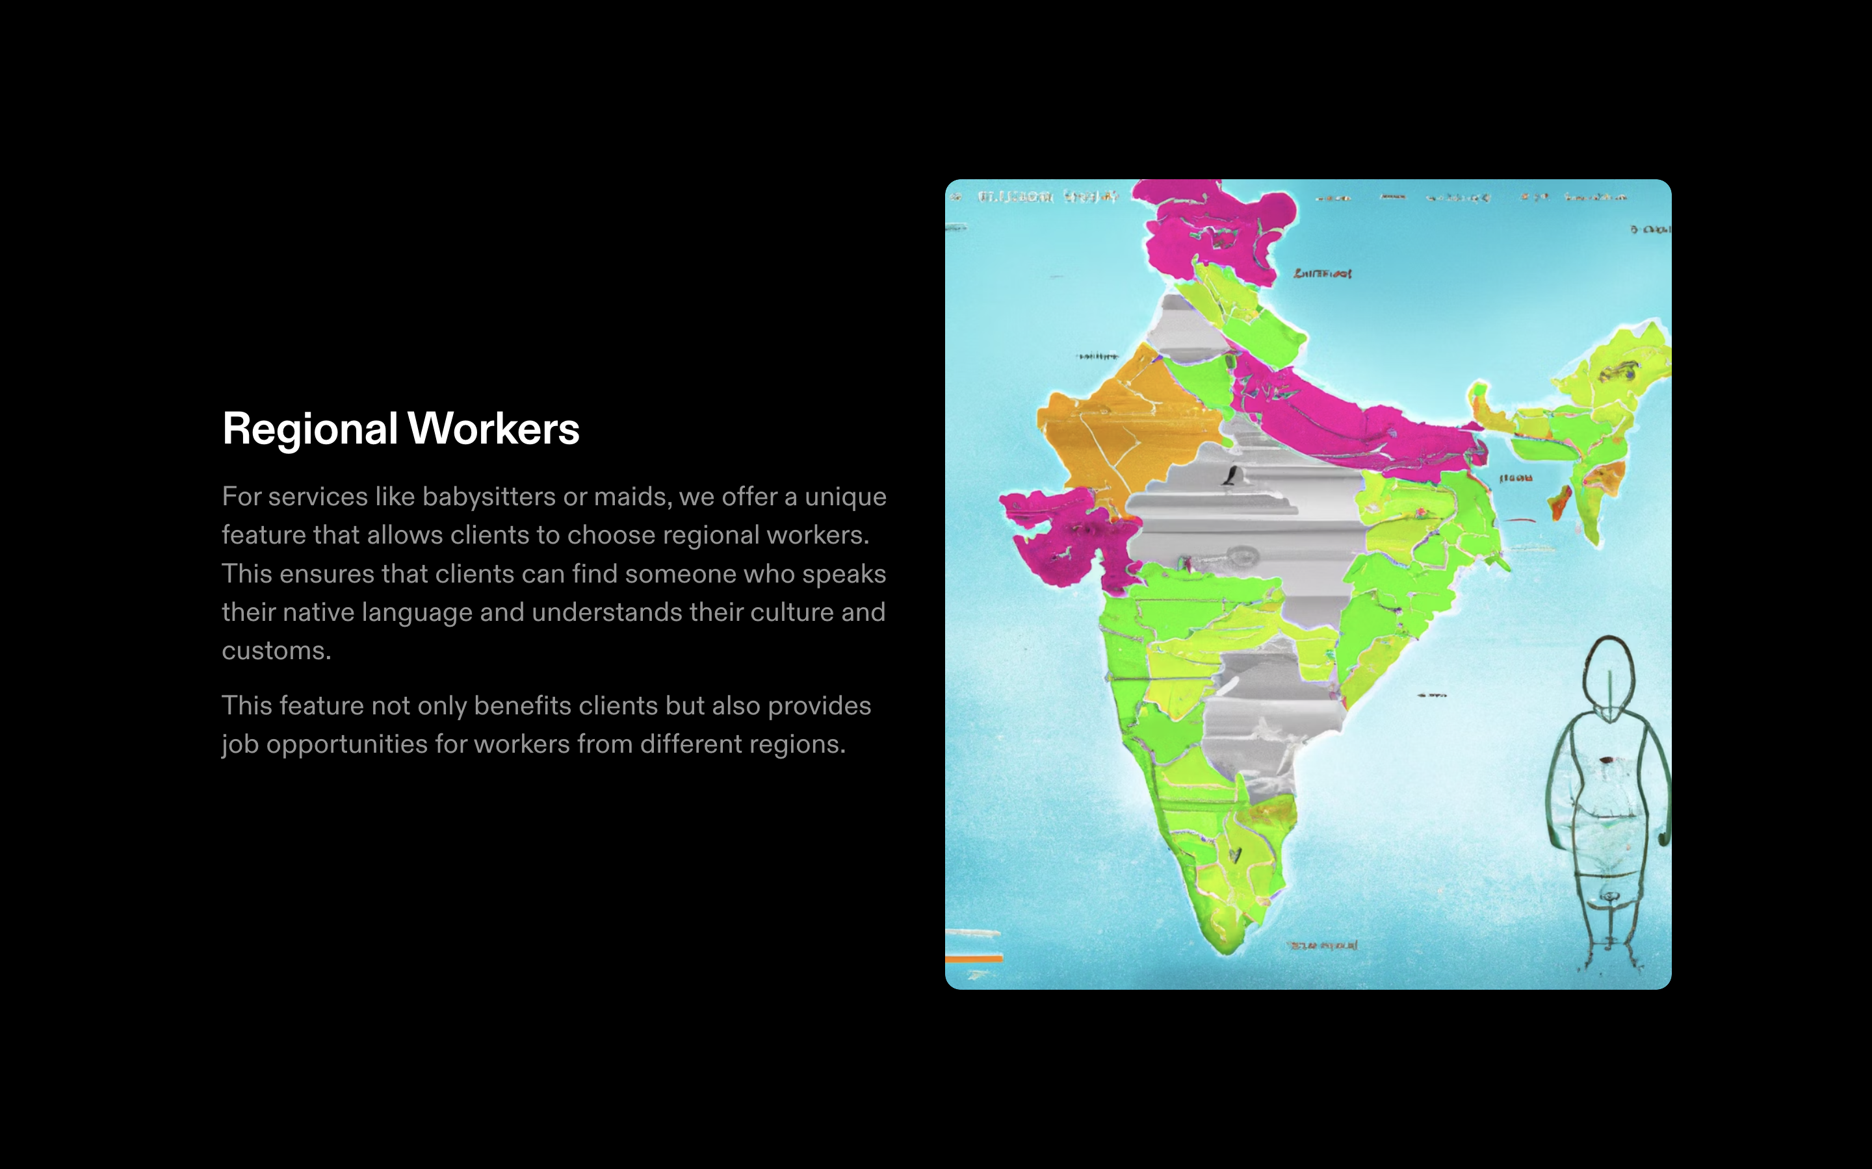

Slide 9
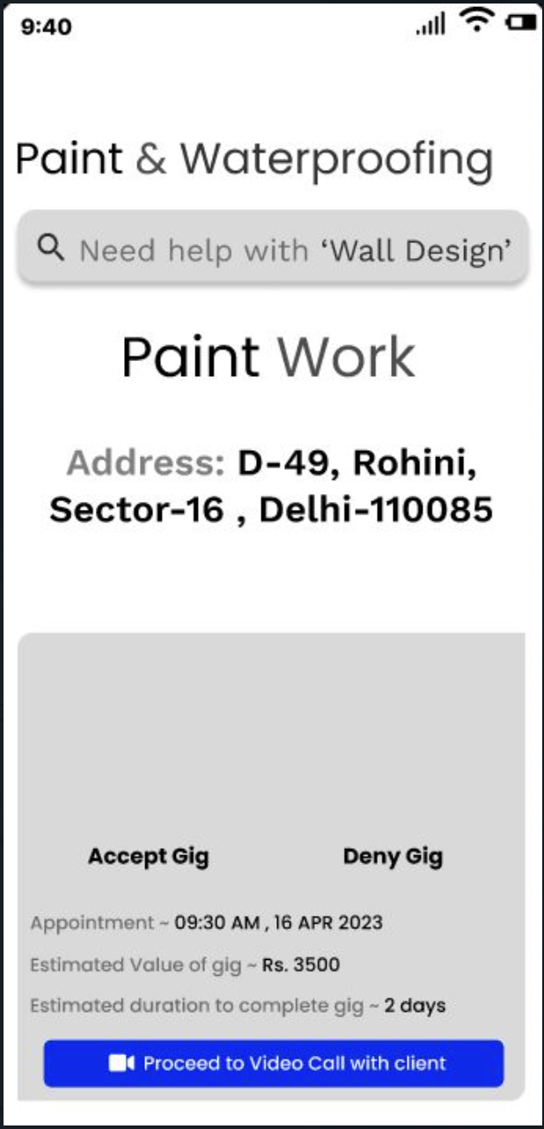
REAL TIME INTERACTION

Slide 10
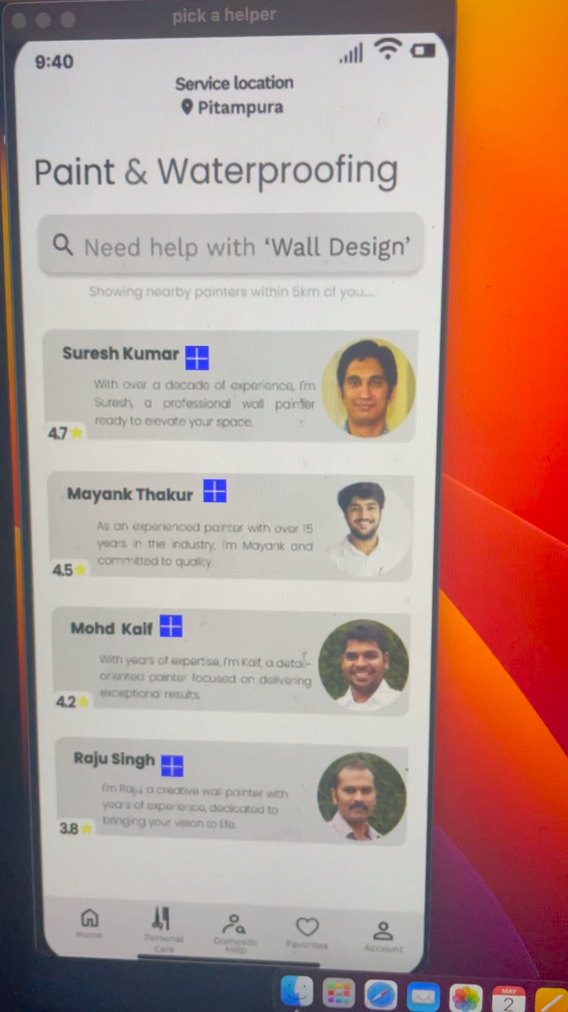
REAL TIME INTERACTION

Slide 11
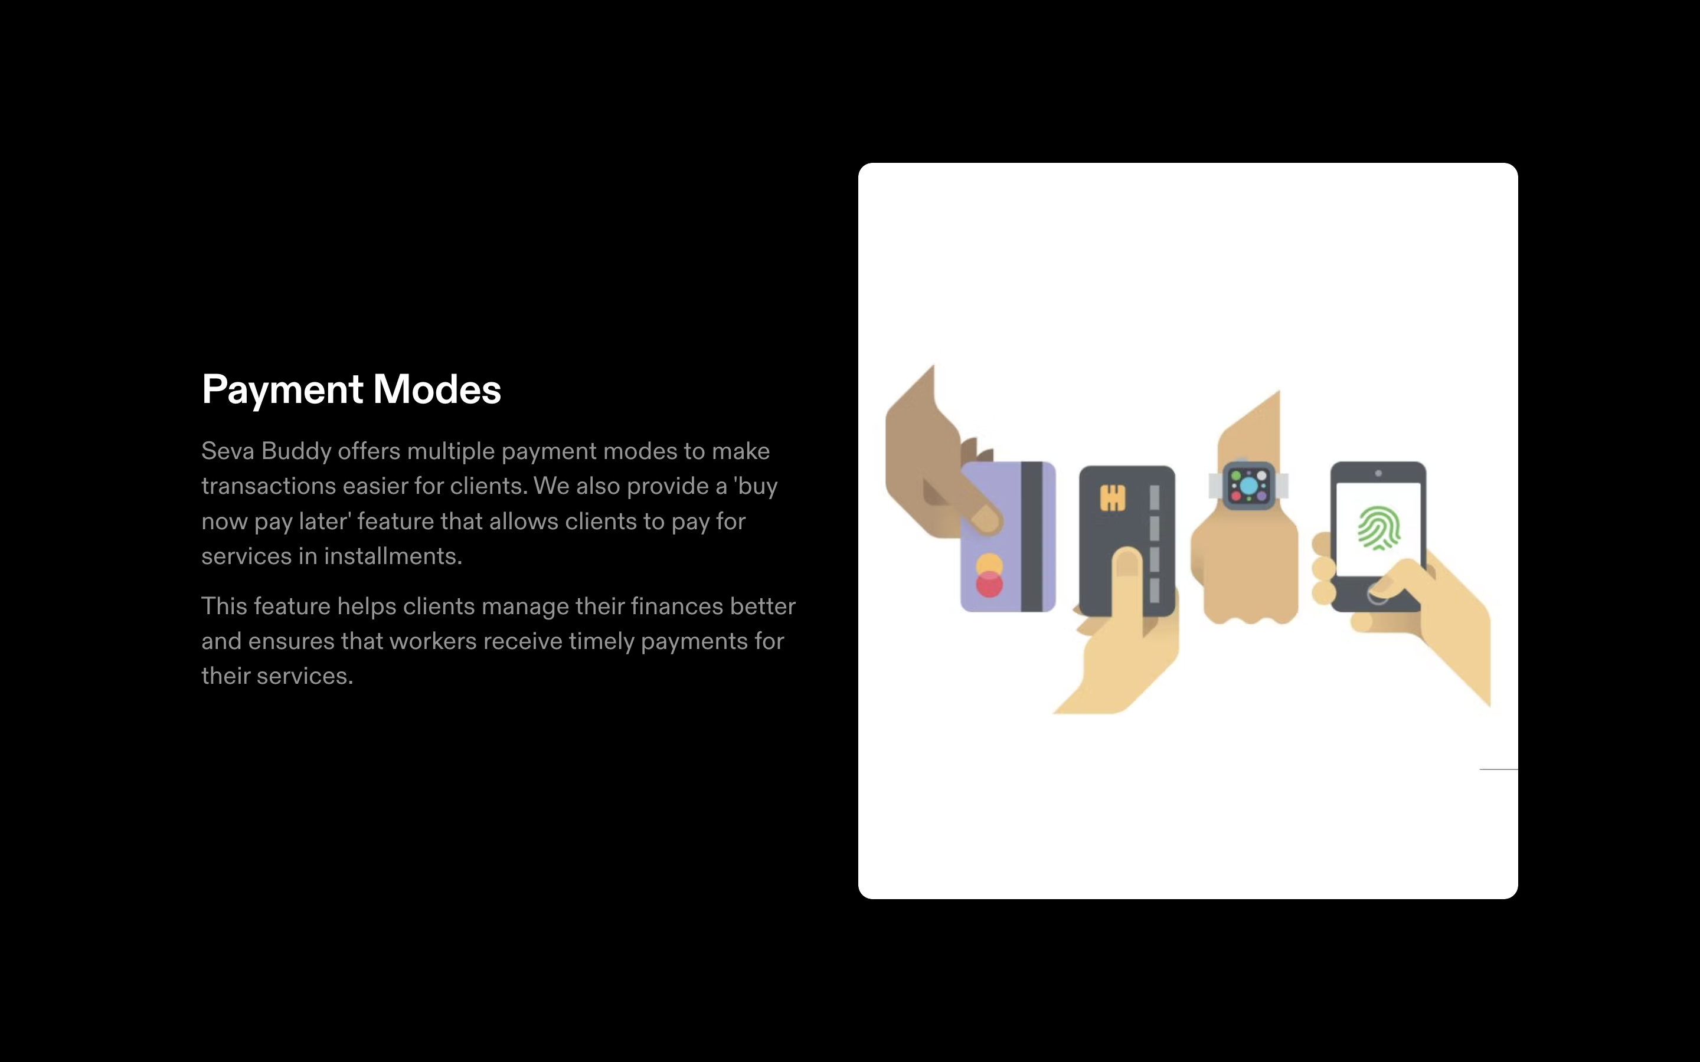

Slide 12
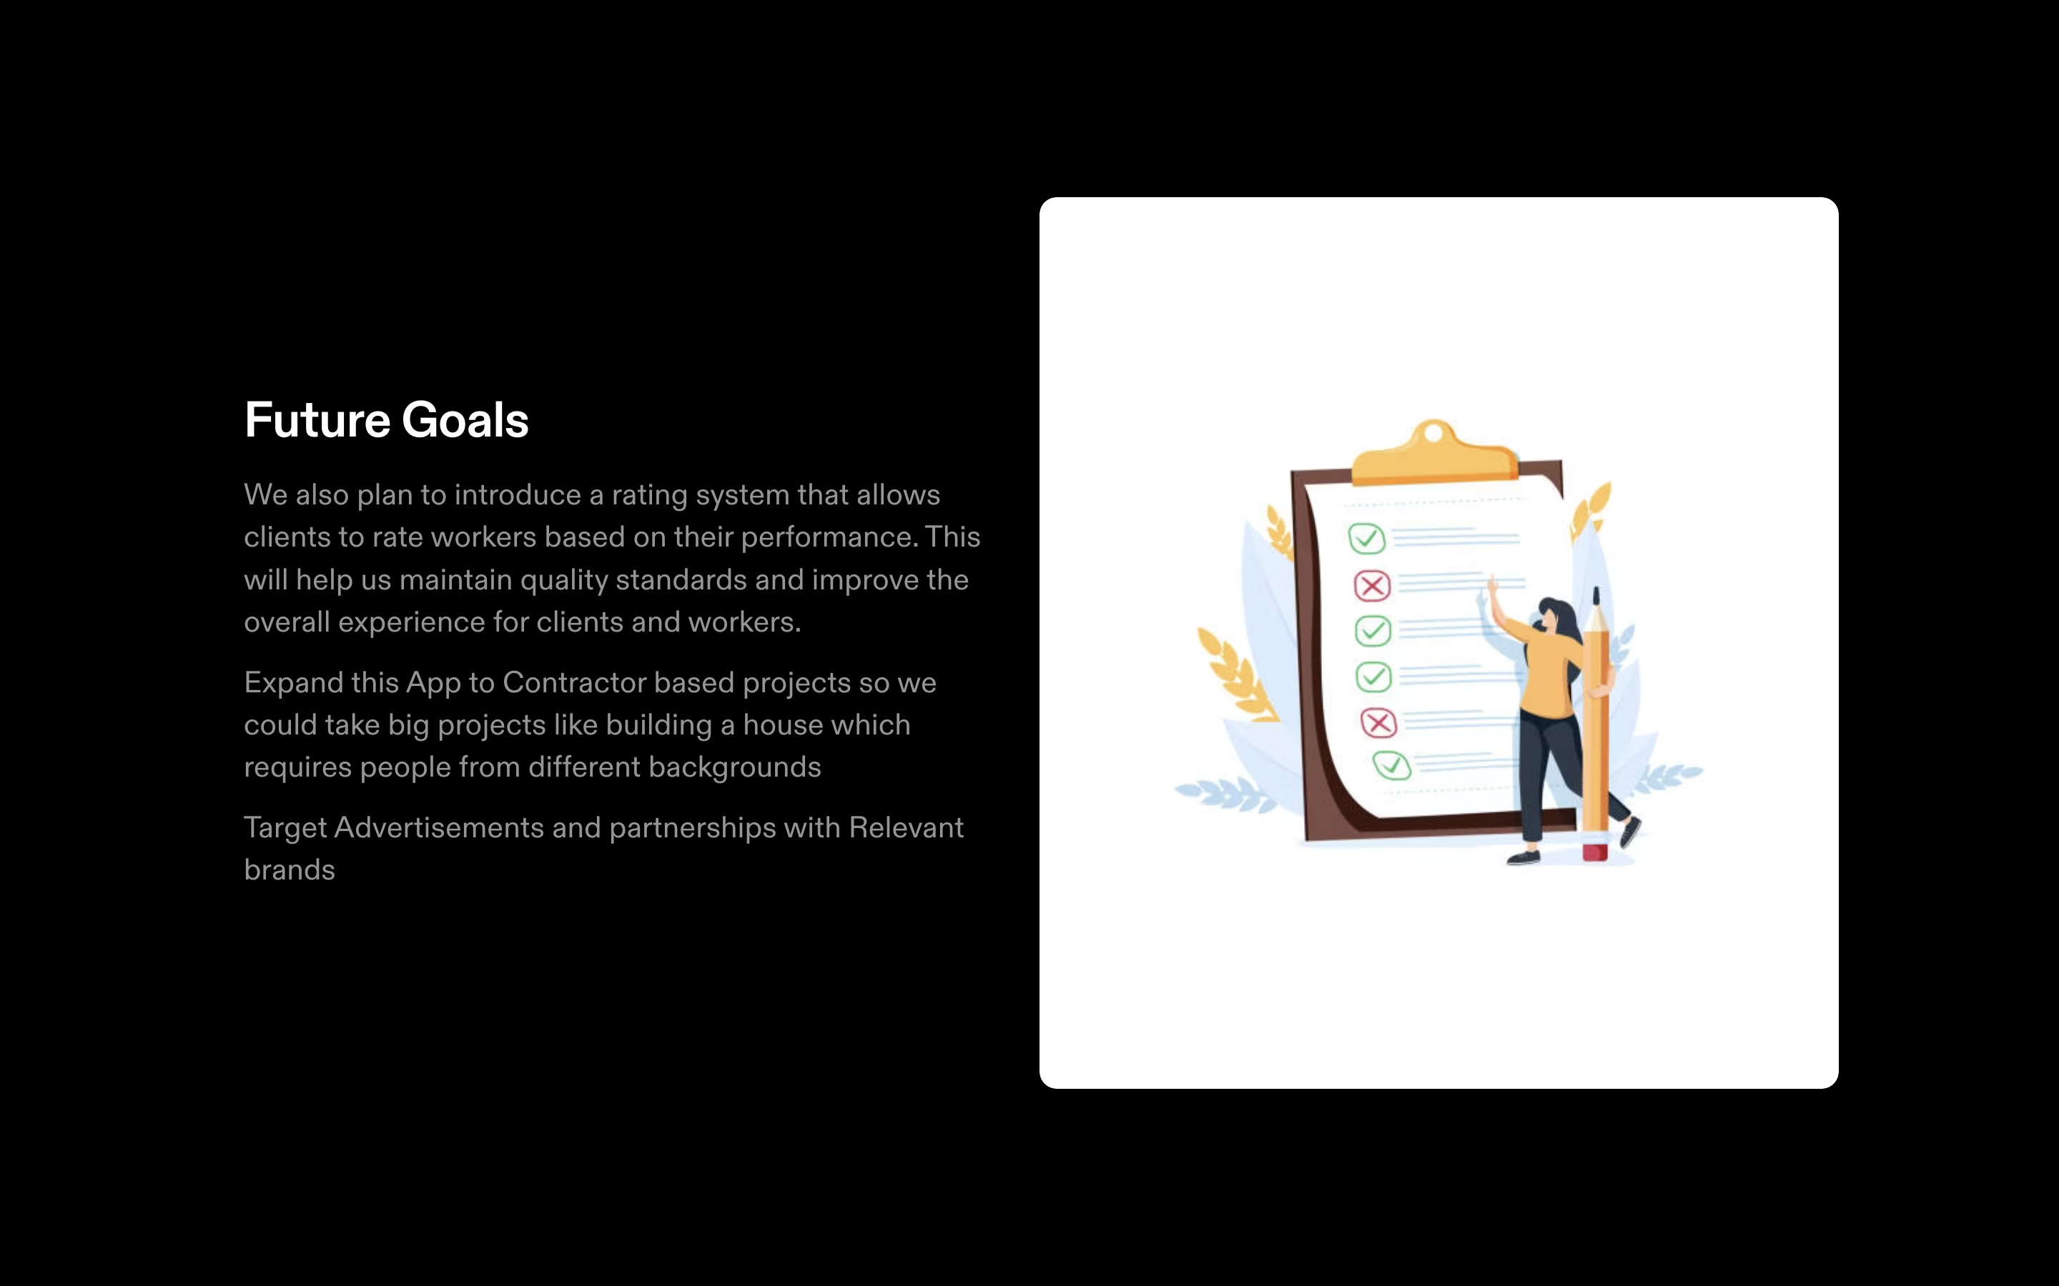

Slide 13
CHALLENGES ::
Competing against the established players can be challenging.
The initial stage of gathering both helpers and customers can take a good amount of time.
Then there is the issue of the helper and customer making a back door deal and doing the job behind our backs

Slide 14
THANK YOU
Revolutionising the service industry…

